Slide 1



Team IT Support
Goldman Sachs X Ellipsis Tech Series

Slide 2

Context & Problem
Rise of NBFCs
Many companies, not just banks, are looking to provide their own financial services
Lack of Expertise
In finance, and more so in financial technology
GS and the Financial Cloud
GS has both experience and expertise, how would they share it?

Slide 3

Targeting SMEs
Who are SMEs?
They are small - medium sized businesses that play an important role in the economy through employment and innovation
What do SMEs want?
Growing SMEs might want to expand their services into the financial landscape industry
Why SMEs?
Due to their nature, they might not have the sufficient expertise to venture into the financial landscape

Slide 4

The Suite by Goldman Sachs
Our solution is a one-stop financial service hub for companies who want to set up and maintain their own financial ecosystem.
This platform provides 3 key features essential to a variety of SME uses, catering to business needs while leveraging on Goldman Sachs’ renowned portfolio.
We also understand that our target demographic vary greatly in size and capital, hence we have decided to give them the ability to choose the exact components they would like to use through a flexible pay-to-use tiering-based subscription system.

Slide 5
Service 1: Payment Infrastructure
Companies – especially those involved in e-commerce or sales – who deal with a large customer base might want to introduce their own payment methods to better help them integrate them into their ecosystem. This is commonly in the form of a credit card.
The Suite aims to leverage on pre-existing architecture and expertise from Goldman Sachs to provide a quick way to build and maintain digital payment methods, while adhering to security and compliance standards.
Users may customise their credit cards by being able to the ability to turn on and off parameters such as interest rates, annual fees, transfer fees and credit line, all in real time.
Users are also able to view usage insights in toggleable weekly, monthly, and yearly values.
Notes:
Put Payment page here, show customisability

Slide 6
Service 2: Data Analytics
For companies that regularly generate vast amounts of data, this feature provides the means to translate that information into meaningful insights that would help guide important decisions.
We aim to do so by leveraging on Goldman Sachs’ pre-existing data analytics software. This removes users’ needs to develop their own data pipelines and models, saving them time by enabling rapid analysis. Additionally, if they provide us with a stream of data that gets updated in set intervals instead of snapshot data, the platform will be able to perform real time analytics, leading to greater accuracy.
Furthermore, companies will have access to years of market insights derived by Goldman Sachs. We hope this provides smaller companies with data that they would not otherwise have and allow them to make better decisions.
Notes:
Put Analytics page here, and try to show that it’s dynamic

Slide 7
Service 3: Asset Management
SMEs tend to struggle with a lack of information in comparison to big firms. Goldman Sachs can leverage their access to expertise in risk management and market analytics to aid SMEs engaging in asset management to make more informed investment decisions with proper information. We aim to provide the following stock information in hopes of helping companies make more insightful decisions,
Historical Pricings of a Selected Stock
Upcoming Listings Available to only Partner Companies
Risk Analysis Calculator
Moreover, regulation is often viewed as a challenge for non banking financial companies to break into the asset management space. In the absence of a banking licence, SMEs are restricted from holding funds of their clients, but by leveraging Goldman Sachs as an established licensed investment banking firm, SMEs that wish to provide asset management services can rely on Goldman Sachs to hold funds for their clients.
Notes:
Put AssMan page here, and try to show ass

Slide 8
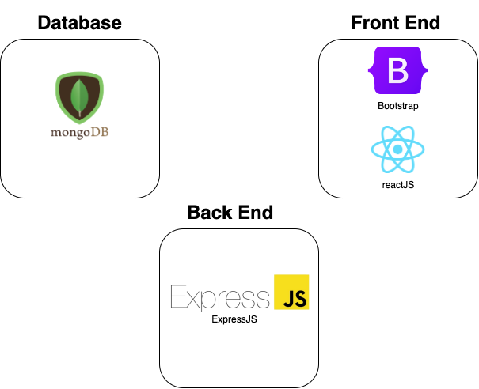
Solution Architecture

Slide 9
Moving Forward
Scaling our Solution with New Implementations
AI Trend Analytics - Analysing market information with AI to improve the time to market to investment products. Values added for users who strive for increased speed in product delivery.
Advanced Analytics - Build on existing data analytics infrastructure, we can aim to improve the scope of our analysis by conducting analysis historical defaults and financial data to generate predicted probability of default rate. This give users the ability to make informed decisions while reducing risk to themselves.
Extension of Related AMS to Fields - Further providing our technologies and insights to other companies in the field, micro financing or investment firms to name a few, These insights can be leveraged upon to make informed decisions. In the context of micro financing companies, these insights allows for better understanding of which companies are in need of micro financing to run their operations .

Slide 10
Business Case
Contribution to Business Strategy | Aligns with Goldman Sachs’ strategy of growing their Asset Management services in markets throughout the world. As more companies adopt The Suite, more companies will subscribe to their Asset Management Services
Benefits | Increase in number of Clients due to the ease of adoption of platform Improvement of public image by partnering with smaller companies Alignment with guiding principles of Corporate Engagement by bringing others along to multiply impact
Costs | Project Management Costs Software Development Costs
Timescales | Total estimated time of 6 months to market
Risks | Because of the likely large number of people who will want to subscribe to the solution, and the lake of a screening process due to the nature of the platform, Goldman Sachs’ brand might be normalised and seem less prestigious even though the quality of service has not changed.

Slide 11
References
Links
Goldman Sachs Partners with Apple on a Game-Changing Credit Card
Firmwide Strategy
Our Purpose and Values
Community Engagement

